Slide 1


HYBRID INTEGRATION Integration Accounts - Service Bus - On-Premises Data Gateway
ROB FOX
www.robfox.io
rob@robfox.io
@xrobfox

Slide 3
WHY IS INTEGRATION MORE IMPORTANT THAN EVER?
App is king
Data is everywhere
Everything is connected
Integration is the backbone
Notes:
Businesses are seen as being innovative
IT is seen as catching up to innovation
3 components: proliferation of apps, data as management nightmare, smart devices that need to interact

Slide 4
INTEGRATION THE CENTER OF DIGITAL TRANSFORMATION
75%
70%
1/2 the cost
of large organizations will establish a hybrid integration platform, by 2020
of the cost of a mobile app project is concerned with integration
of implementing IoT solutions will be spent integrating the various IoT components with each other and the back-end systems, through 2018
Source: Gartner “Market Guide for Hybrid Integration Platform-Enabling Technologies,” by Elizabeth Golluscio, Jess Thompson, Keith Guttridge, April 25, 2016
Notes:
Recent gartner report on hybrid integration platform:
By 2020 75% of organizations will establish a hybrid integration platform
70% of mobile app project is going to be concerned with integration
50% of cost of implementing an IoT solution will be spent on integration

Slide 5
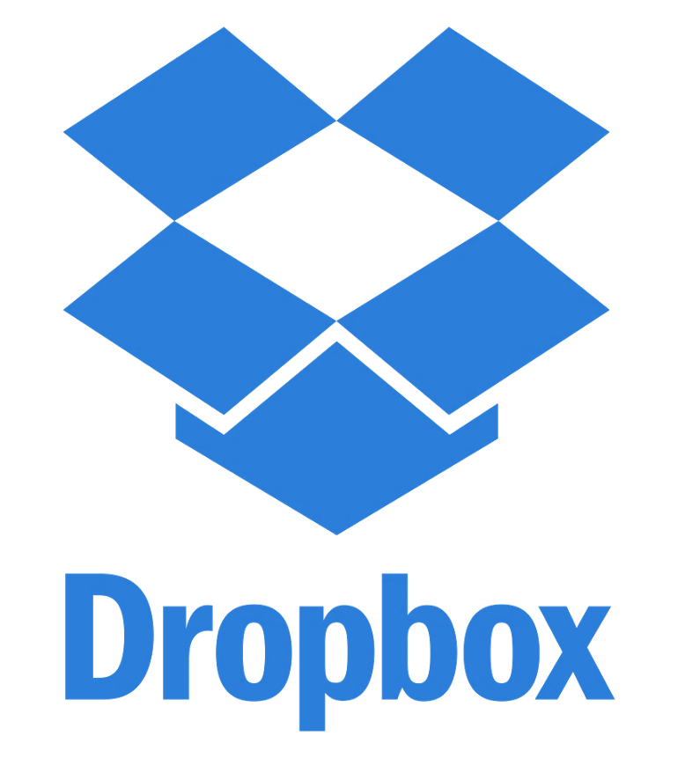

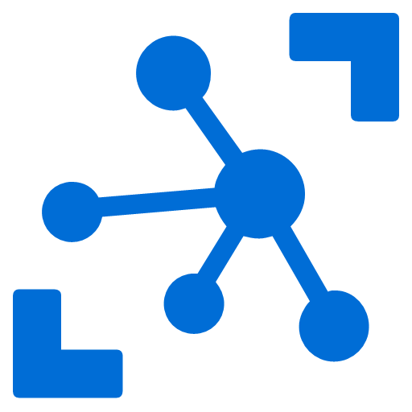
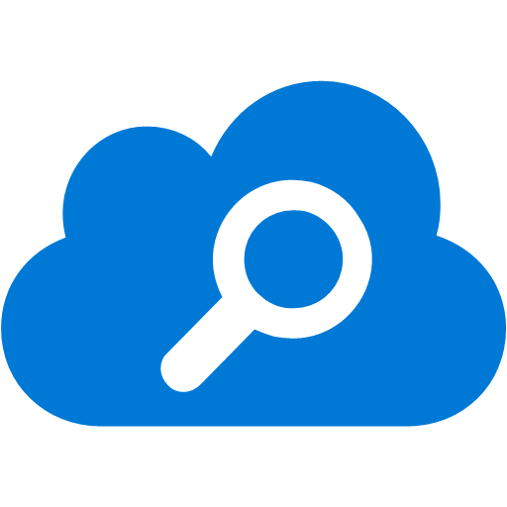
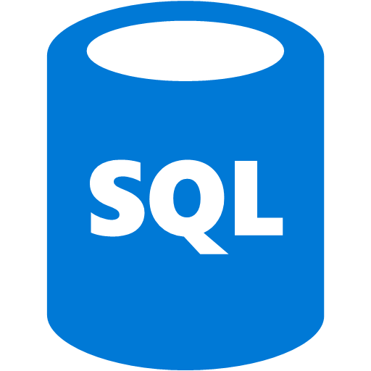
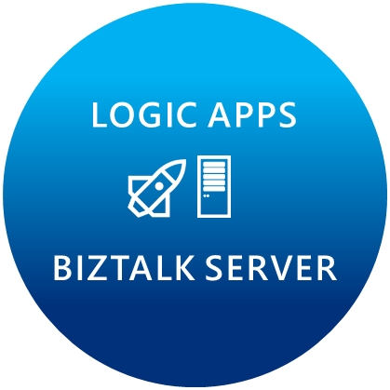
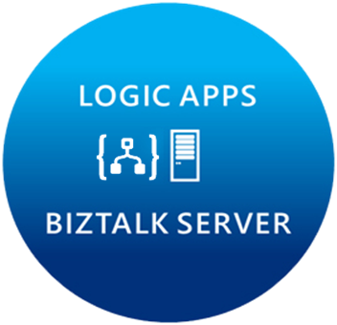
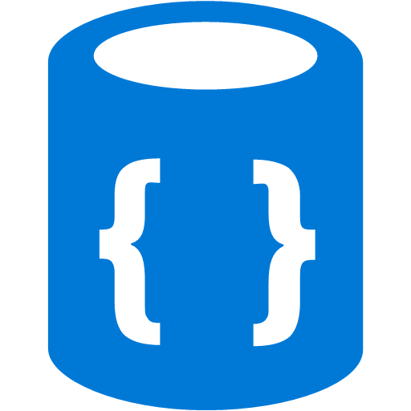
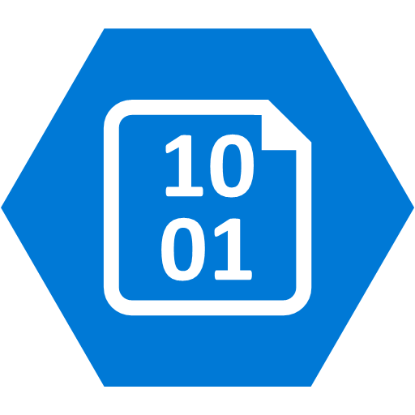
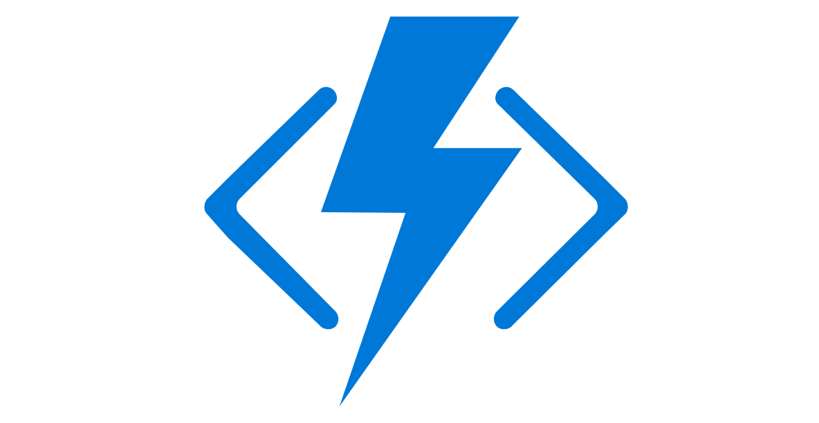


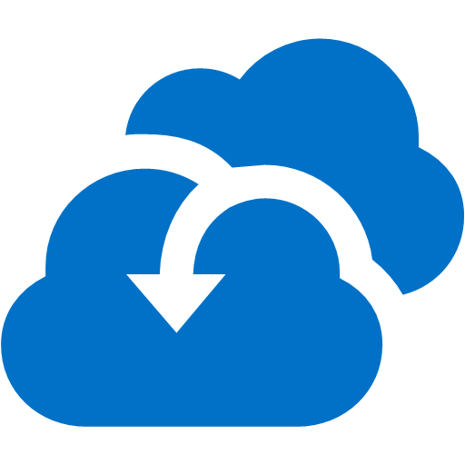

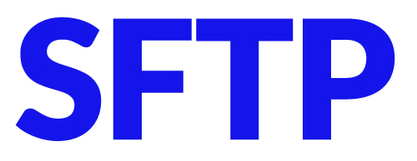
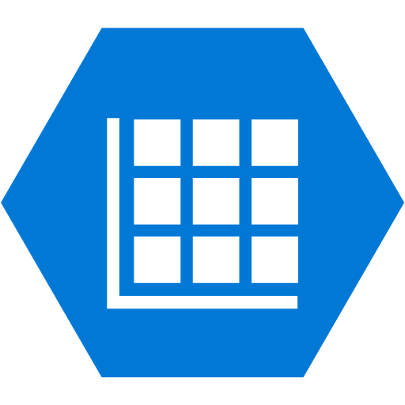



Microsoft’s Hybrid Integration Platform
API MANAGEMENT
AZURE SERVICE BUS
IoT/Event Hub
Azure Search
SQL Database
CONNECTORS
AZURE SERVICES
AZURE SERVICE BUS
DocDB
BLOB Storage
Functions
API MANAGMENT
Machine Learning
HD Insight
Site Recovery
B2B/EDI
Tables
Cognitive Services
DNS
Notes:
Its not just about the products, we have a pool of out-of-the-box connectors that help connect to many SaaS applications.
Secret sauce is really the Azure services.
Azure is now at your fingertips – opens doors to numerous possibilities.
Traditional integration vendors, ask customers to build silo-ed integration solutions.
That approach is not going to allow you to scale to your customer needs.
With Azure, you can build holistic solutions.
I can do more than integration – once you have your connected system, you can perform analytics on the data using HD insight, machine learning, to gain insight on your data.
This is going to help customers make great business decisions.
Some of you have IoT practices today, this is how you can leverage integration and IoT together.
At MSFT, we think that there are multiple points of entry into integration: Think about your customers who reach out to you about mobile development, about IoT solutions, any e-commerce applications, eventually they are going to need a solid integration platform – and that’s what MSFT offers.
2 key differentiating factors to highlight again:
Hybrid 2. Azure Services

Slide 6
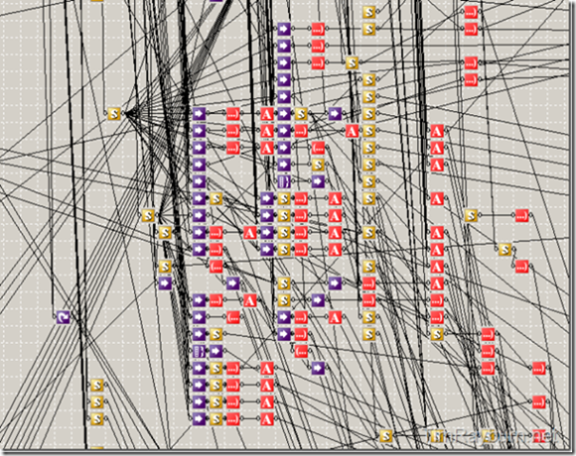
INTEGRATION ACCOUNTS
AKA Enterprise Integration Pack

Slide 7
INTEGRATION ACCOUNTS
Placeholder for:
Schemas
Maps
Partners
Agreements
Certificates (KeyVault integration)
Works together with Logic Apps
Easy to manage
REST API, PowerShell, Portal, Visual Studio
Secure, scalable, manageable
Schemas
Maps
TPM
Custom
Config
Notes:
An integration account allows enterprise integration apps to manage artifacts, including schemas, maps, certificates, partners and agreements. Any integration app you create uses an integration account to access these schemas, maps, certificates, and so on.

Slide 8
INTEGRATION ACCOUNTS
For whom?
Businesses that are still using classical messaging and want to move stuff to the cloud
Typical scenarios
Working with data in flat files
Classical SOAP/ XML services
EDI integration solutions
Use Visual Studio to develop schemas and maps
Upload artifacts to the Azure portal
Schemas
Maps
TPM
Custom
Config

Slide 9
INTEGRATION ACCOUNTS: Enterprise Messaging
Validate
Extract
Transform
Enrich
Route
XML Validation
@xpath
XSL Transform
Compose
Send message to topic
VETER Pipeline
Reference schema in Integration Account
Select literals, single nodes or node-sets
BizTalk mapper compatibility
Parameter support (enrich)
Construct a new message
Notes:
Looks like: BizTalk Pipeline

Slide 10
PRICING
Schemas
Integration Account
$ 1000 / month
Enterprise Connection (e.g. SAP)
$ 800 / connection / month
Free tier for development
1 integration account per region
10 agreements
25 maps
Maps
TPM
Custom
Config
Notes:
Included in consumption-based usage is an integration account for exploration, development, and testing purposes allowing you to use the B2B/EDI and XML processing features of Logic Apps at no additional cost. You are able to create a maximum of one account per region and store up to 10 Agreements and 25 maps. Schemas, certificates, and partners have no limits and you can upload as many as you need.
In addition to the inclusion of integration accounts with consumption, you can also create standard integration accounts without these limits and with our standard Logic Apps SLA. For more information, see Azure pricing.

Slide 11
DEMO
Integration Accounts
Notes:
Show how to upload schemas
Show how to link to logic app
Show how to call in logic app

Slide 12

SERVICE BUS
The online postal service

Slide 13
Service Bus
Just as old as Azure itself
Service Bus Messaging (AMQP)
Queues
Topics
Azure Relay (WCF Relay)
SOAP, WS-* and REST
Optimized for .Net
Notes:
Service Bus Messaging, or brokered messaging can be thought of as asynchronous, or "temporally decoupled." Producers (senders) and consumers (receivers) do not have to be online at the same time. The messaging infrastructure reliably stores messages in a "broker" (such as a queue) until the consuming party is ready to receive them. This allows the components of the distributed application to be disconnected, either voluntarily; for example, for maintenance, or due to a component crash, without affecting the entire system. Furthermore, the receiving application may only have to come online during certain times of the day, such as an inventory management system that only is required to run at the end of the business day.
The WCF Relay component of Service Bus is a centralized (but highly load-balanced) service that supports a variety of different transport protocols and Web services standards. This includes SOAP, WS-*, and even REST. The relay service provides a variety of different relay connectivity options and can help negotiate direct peer-to-peer connections when it is possible. Service Bus is optimized for .NET developers who use the Windows Communication Foundation (WCF), both with regard to performance and usability, and provides full access to its relay service through SOAP and REST interfaces. This makes it possible for any SOAP or REST programming environment to integrate with Service Bus.

Slide 14
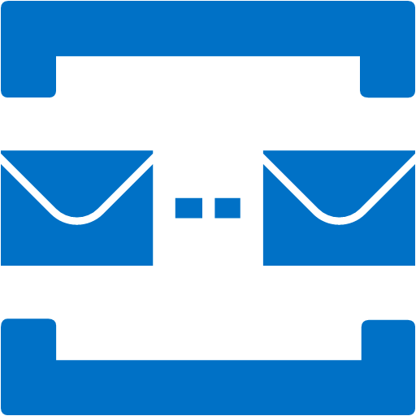
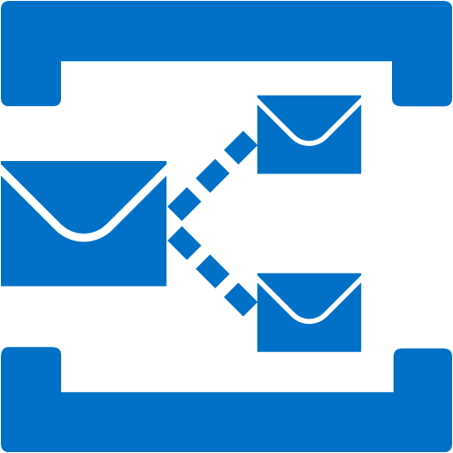
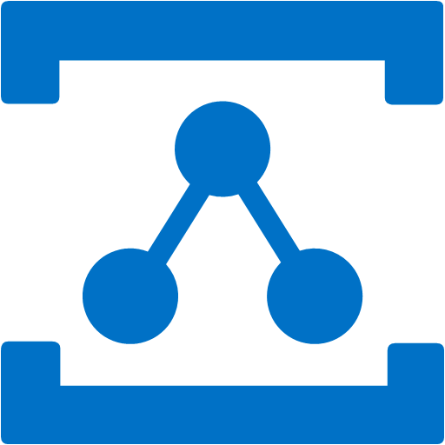

ADVANCED MESSAGE QUEUING PROTOCOL
NAMESPACE 1
NAMESPACE 2
NAMESPACE 3
Queue A
Queue B
Topic A
Relay A
Topic A
Topic B
Relay A
APPLICATIONS
APPLICATIONS
APPLICATIONS
Notes:
A namespace is a common container for all messaging components. Multiple queues and topics can reside in a single namespace, and namespaces often serve as application containers. There are currently two different ways to create a Service Bus namespace.

Slide 15




QUEUES
SENDER
SERVICE BUS NAMESPACE
RECEIVER
Queue
Logic
Body
Properties
Key1 Value1
Key2 Value2
Key3 Value3
Key4 Value4
Notes:
A Service Bus queue is an entity in which messages are stored. Queues are particularly useful when you have multiple applications, or multiple parts of a distributed application that need to communicate with each other. The queue is similar to a distribution center in that multiple products (messages) are received and then sent from that location.
Queues offer First In, First Out (FIFO) message delivery to one or more competing consumers. That is, messages are typically expected to be received and processed by the receivers in the order in which they were added to the queue, and each message is received and processed by only one message consumer. A key benefit of using queues is to achieve "temporal decoupling" of application components. In other words, the producers (senders) and consumers (receivers) do not have to be sending and receiving messages at the same time, because messages are stored durably in the queue. Furthermore, the producer does not have to wait for a reply from the consumer in order to continue to process and send messages.

Slide 16
QUEUES
Queues are just like, uhm… queues. So it’s First In, First Out (FIFO)
A queue can have only one (competing) consumer

Slide 17
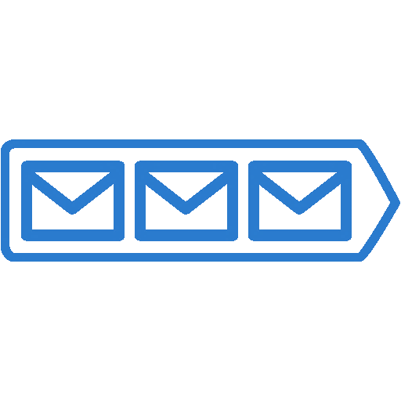

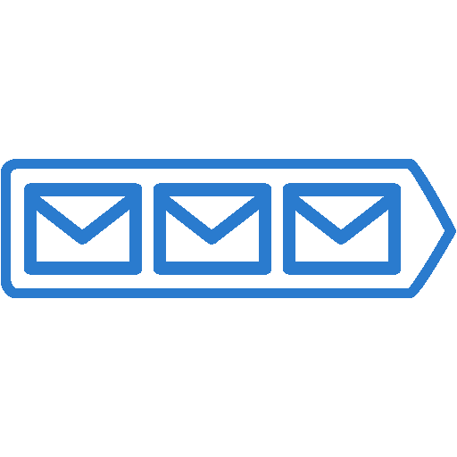
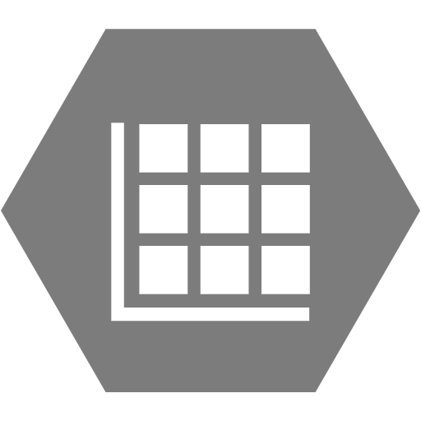
TOPICS
SENDER
SERVICE BUS NAMESPACE
RECEIVER
Subscription 1
Topic
Logic
Subscription 2
Storage
Notes:
A topic can be visualized as a queue and when using multiple subscriptions, it becomes a richer messaging model; essentially a one-to-many communication tool. This publish/subscribe model (or pub/sub) enables an application that sends a message to a topic with multiple subscriptions to have that message received by multiple applications.
In contrast to queues, in which each message is processed by a single consumer, topics and subscriptions provide a one-to-many form of communication, in a publish/subscribe pattern. Useful for scaling to very large numbers of recipients, each published message is made available to each subscription registered with the topic. Messages are sent to a topic and delivered to one or more associated subscriptions, depending on filter rules that can be set on a per-subscription basis. The subscriptions can use additional filters to restrict the messages that they want to receive. Messages are sent to a topic in the same way they are sent to a queue, but messages are not received from the topic directly. Instead, they are received from subscriptions. A topic subscription resembles a virtual queue that receives copies of the messages that are sent to the topic. Messages are received from a subscription identically to the way they are received from a queue.

Slide 18
TOPICS
One-to-many: 1 topic can have multiple subscribers
Subscription is a virtual queue that receives a copy of a message sent to the topic
Filters are written in SQL92 style
e.g. firstname = ‘Rob’ AND lastname = ‘Fox’

Slide 19

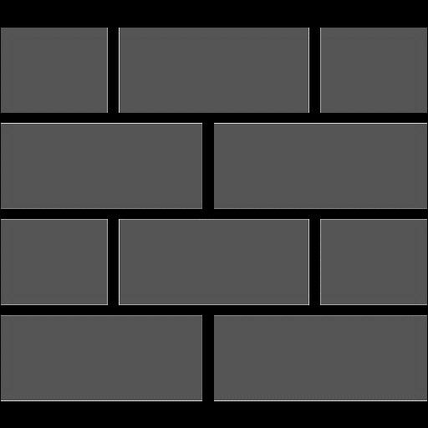
RELAYS
SENDER
SERVICE BUS NAMESPACE
RECEIVER (ON-PREMISE)
FIREWALL
NAT
Relay service
On-Premise
Applications
Notes:
The relay service supports traditional one-way messaging, request/response messaging, and peer-to-peer messaging. It also supports event distribution at Internet-scope to enable publish-subscribe scenarios and bi-directional socket communication for increased point-to-point efficiency. In the relayed messaging pattern, an on-premises service connects to the relay service through an outbound port and creates a bi-directional socket for communication tied to a particular rendezvous address. The client can then communicate with the on-premises service by sending messages to the relay service targeting the rendezvous address. The relay service will then "relay" messages to the on-premises service through the bi-directional socket already in place. The client does not need a direct connection to the on-premises service, nor is it required to know where the service resides, and the on-premises service does not need any inbound ports open on the firewall.
You initiate the connection between your on-premises service and the relay service, using a suite of WCF "relay" bindings. Behind the scenes, the relay bindings map to transport binding elements designed to create WCF channel components that integrate with Service Bus in the cloud.
WCF Relay provides many benefits, but requires the server and client to both be online at the same time in order to send and receive messages. This is not optimal for HTTP-style communication, in which the requests may not be typically long-lived, nor for clients that connect only occasionally, such as browsers, mobile applications, and so on. Brokered messaging supports decoupled communication, and has its own advantages; clients and servers can connect when needed and perform their operations in an asynchronous manner.

Slide 20
RELAYS
Voorbeeld?

Slide 21
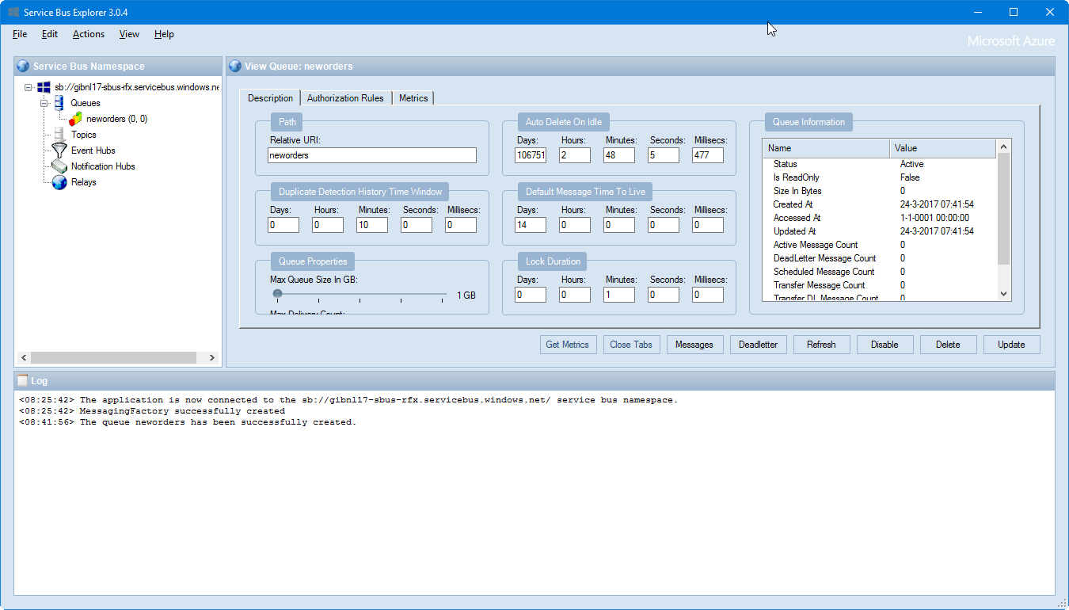
SERVICE BUS EXPLORER

Slide 22
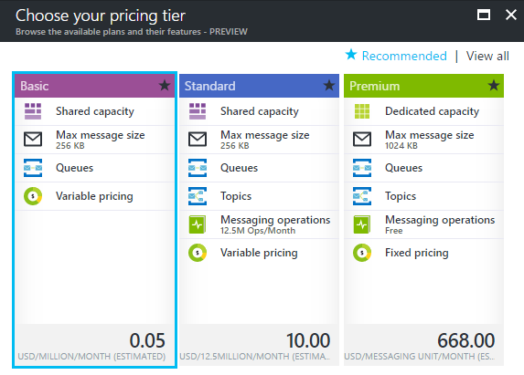
PRICING

Slide 23
PRICING – WHAT’S INCLUDED
Basic
No base charge
Only queues
Max. message size 256 kB
100 brokered connections
Standard
$10/month
All
Max. message size 256 kB
1000 brokered connections
Premium
$22.26 fixed rate/day/MU
All
Max. message size 1 MB
1000 brokered connections per MU

Slide 24
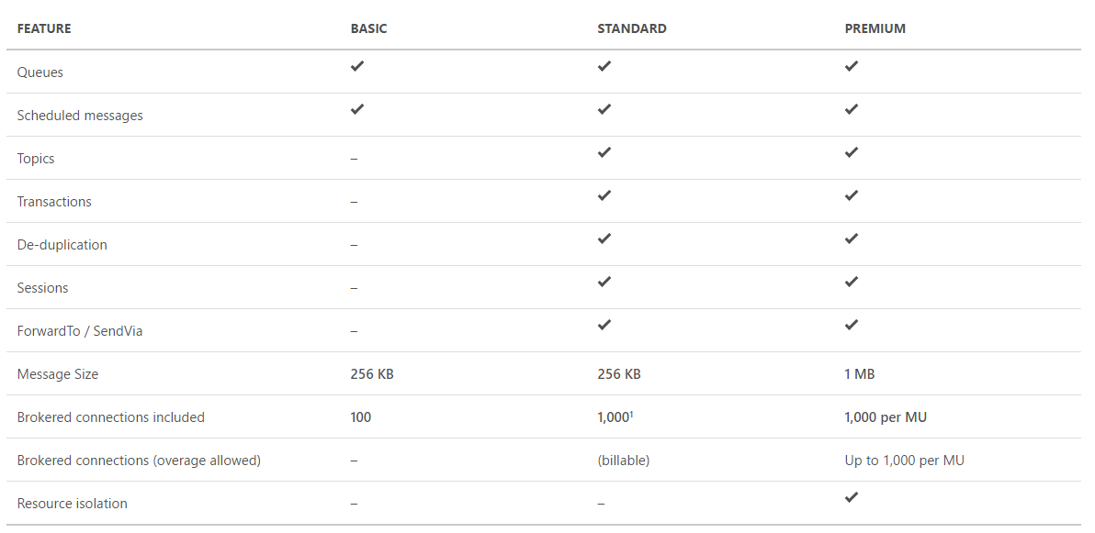
Notes:
¹1,000 Brokered Connections are included with the Standard Messaging tier (via the Base Charge) and can be shared across all queues, topics/subscriptions and Event Hubs within the associated Azure Subscription.Service Bus Premium runs in dedicated resources to provide higher throughput and more consistent performance.

Slide 25
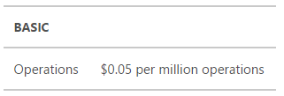
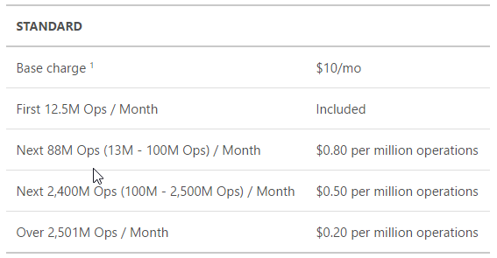
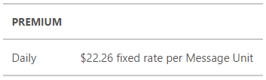
PRICING – MESSAGING OPERATIONS
An operation is any API call to the Service Bus service.

Slide 26
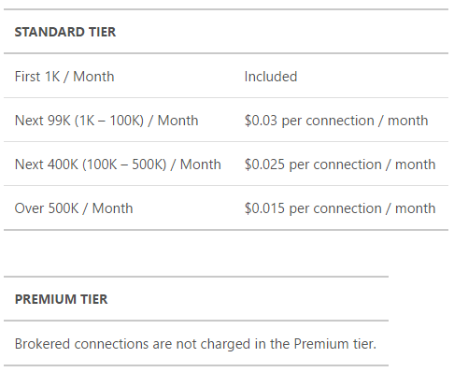
PRICING – BROKERED CONNECTIONS
Number of AMQP connections or HTTP calls to Service Bus.

Slide 27
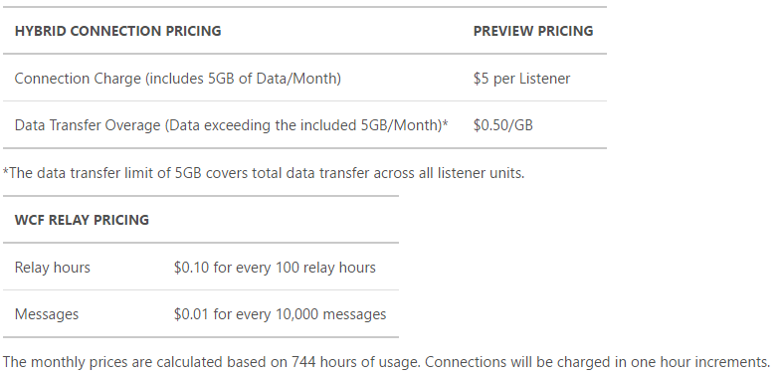
PRICING - RELAYS
Hybrid connections are charged per Listener unit and for any data overage exceeding the included 5GB/Month. WCF Relays are charged by message volume and relay hours.

Slide 28
DEMO
Service Bus Queues, Topics and Relays

Slide 29
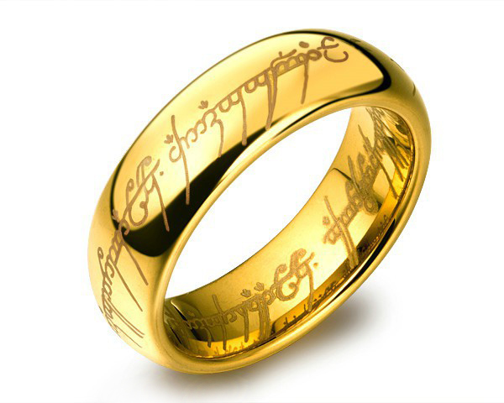
ON-PREMISES DATA GATEWAY
One gateway to rule them all

Slide 30
On-Premises Data Gateway
Secure data transfer between on-prem resources and Azure
No inbound firewall rules required
Runs as a Windows service on-prem
Cloud resources supported:
Logic Apps
Power Apps
Microsoft Flow
PowerBI
Azure Analysis Services

Slide 31



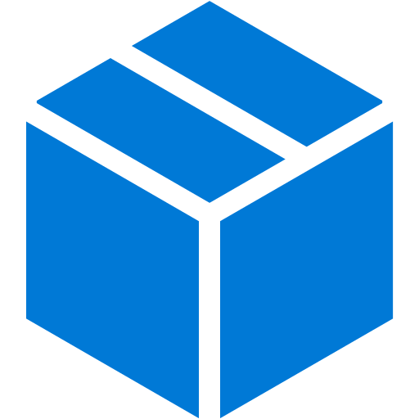
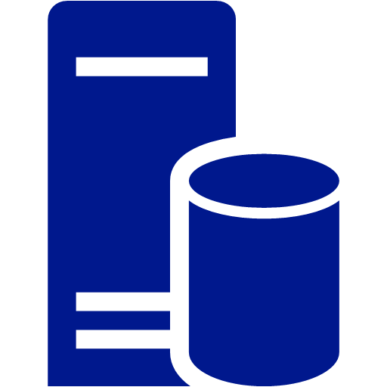
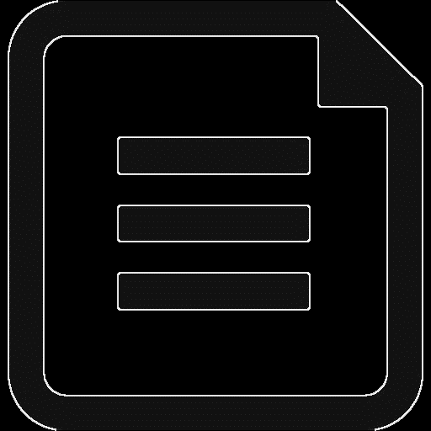
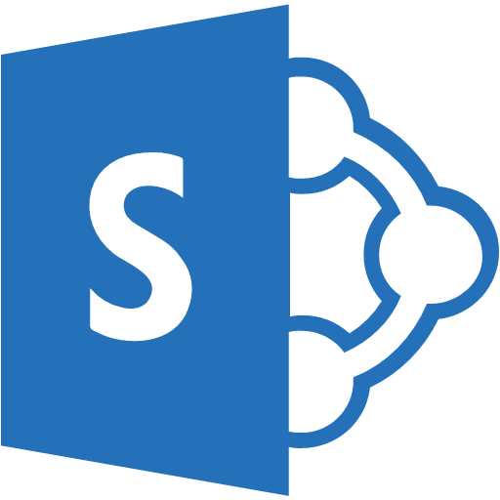
ONE GATEWAY FOR MULTIPLE CLOUD SERVICES AND EXPERIENCES
Cloud services
AZURE ANAYSIS SERVICES
POWER BI
POWER APPS
MICROSOFT FLOW
AZURE LOGIC APPS
Gateway Cloud Service Date source connection credentials are encrypted
Azure Service Bus
Application Gateway Date source connection credentials can only be
decrypted by the gateway
On premises data sources
SQL SERVER
SQL SERVER ANALYSIS SERVICES
OTHER DATA SOURCES
FILES, SHAREPOINT
Notes:
1) A query will be created by the cloud service, along with the encrypted credentials for the on-premises data source, and sent to the queue for the gateway to process.
2) The gateway cloud service will analyze the query and will push the request to the Azure Service Bus.
3) The on-premises data gateway polls the Azure Service Bus for pending requests.
4) The gateway gets the query, decrypts the credentials and connects to the data source(s) with those credentials.
5) The gateway sends the query to the data source for execution.
6) The results are sent from the data source, back to the gateway, and then onto the cloud service. The service then uses the results.

Slide 32
DATA SOURCES
Analysis Services Tabular
Analysis Services Multidimensional
SQL Server
SAP HANA
Oracle
Teradata
File
Folder
SharePoint list (on-premises)
Web
OData
IBM DB2
MySQL
Sybase
SAP BW
IBM Informix Database
ODBC

Slide 33
ACCOUNTS
Personal accounts (like @outlook.com or @hotmail.com) won’t work
You have two options:
Use a school or work account to create an account
Setup your own active directory in Azure

Slide 34
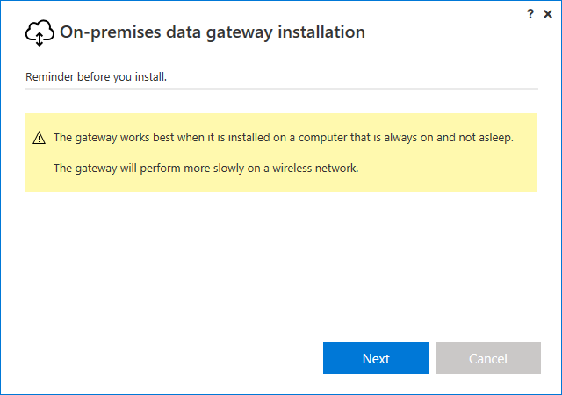
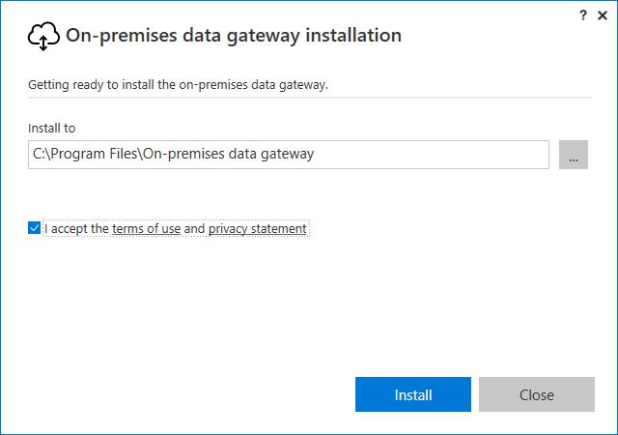
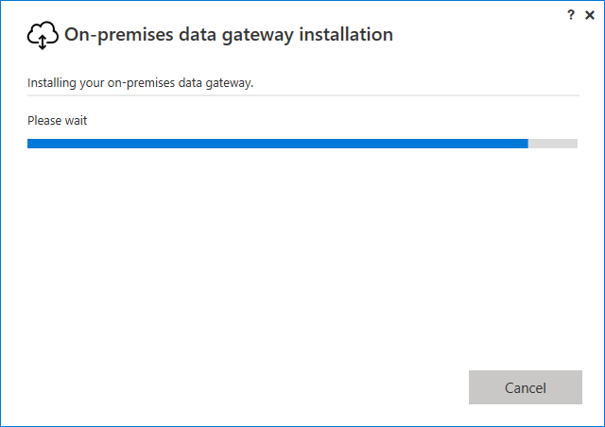
DOWNLOAD AND INSTALL
https://www.microsoft.com/en-us/download/details.aspx?id=53127

Slide 35
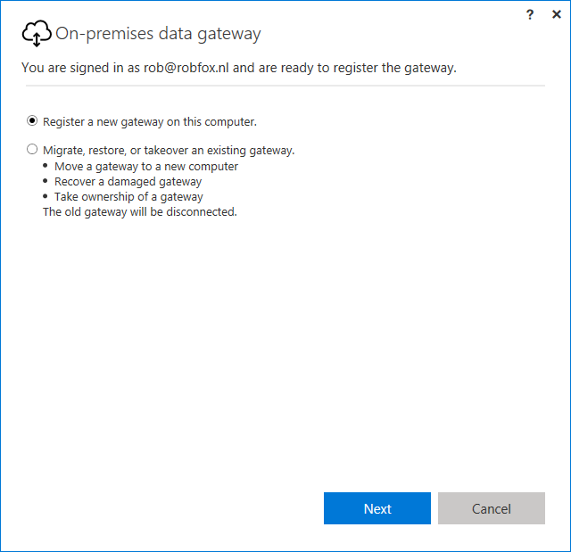
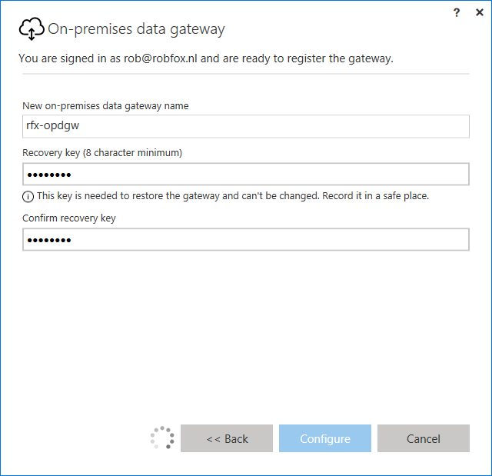
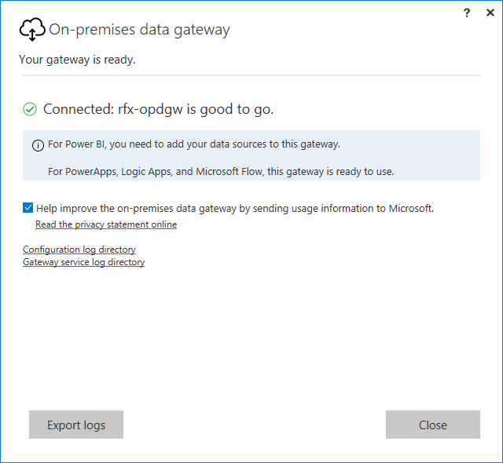
CONFIGURE
After successful login, configure the gateway

Slide 36
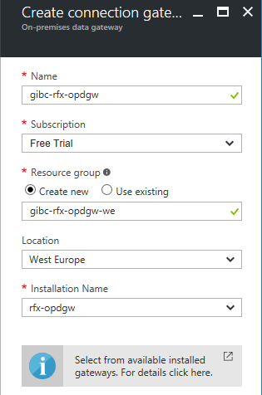
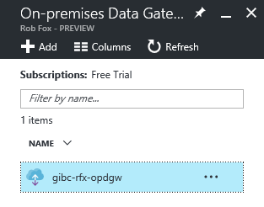
CONNECT WITH AZURE

Slide 37
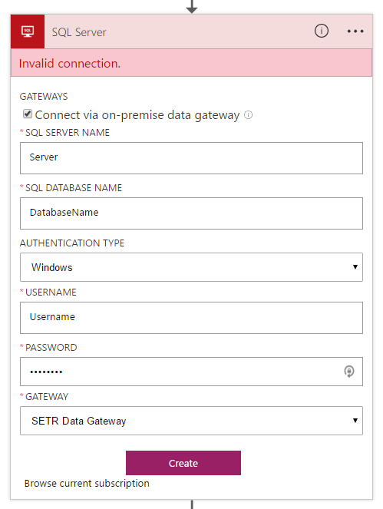
USING THE GATEWAY
Use within Logic Apps
Free of charge
Your usage of the components will be charged

Slide 38
DEMO
On-premises Data Gateway
Notes:
Just show the Enterp

Slide 39
LAB #2
Enterprise Accounts and the On-premises Data Gateway

Slide 40

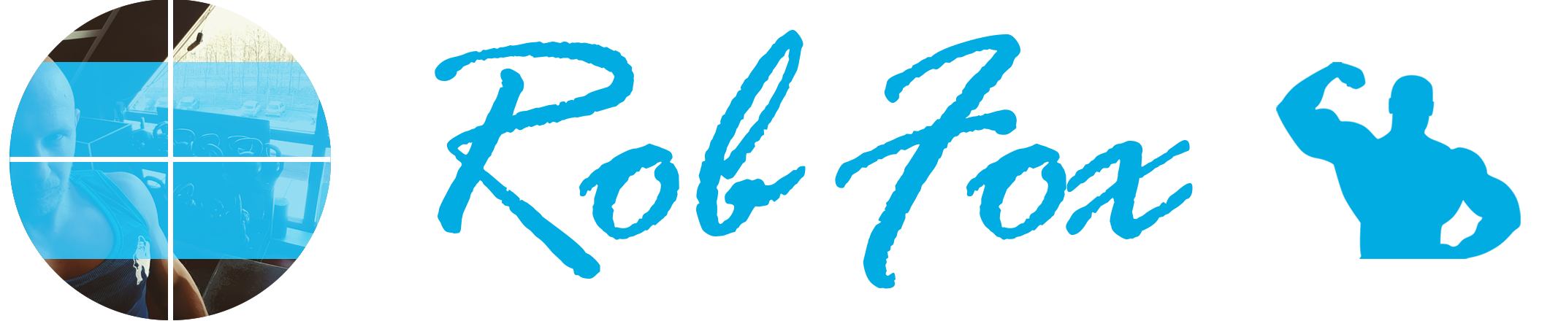

www.robfox.io
rob@robfox.io
@xrobfox

